Slide 1
The Central Processing Unit (CPU) and
Machine Language
CSCI 1101 Introduction to Computer Science
Notes:
<number>

Slide 2
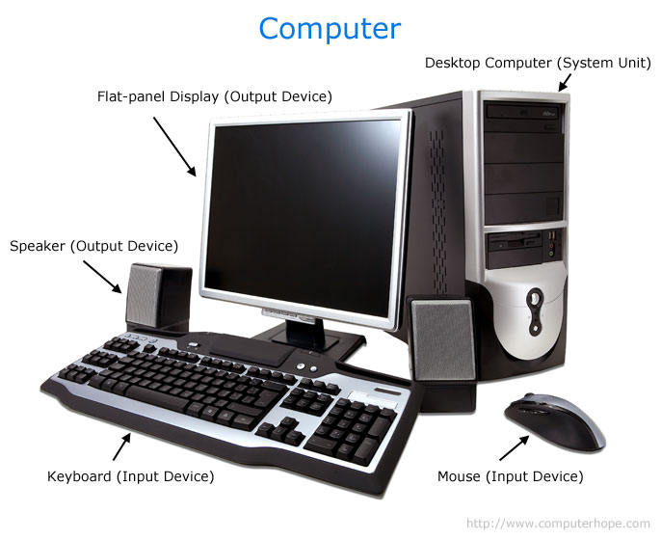
Computer System
Hardware
Computer System
Software
All those parts of a computer that you
can see and touch.
Programs (set of instructions) and
data.

Slide 3
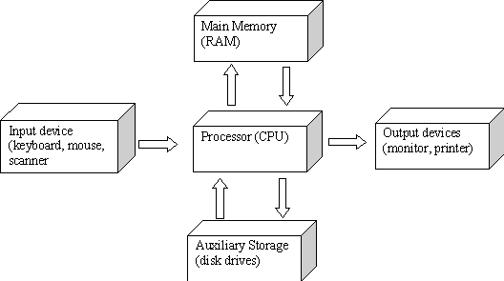
Hardware
Computer
http://www.antonine-education.co.uk/ict_as/ict_module_2/topic_8/computer_architecture.htm
Notes:
<number>

Slide 4
Computing Hardware Essentials
Motherboard
Main circuit board of the machine
Central Processing Unit (CPU) or processor
Circuitry that controls data manipulation
Main Memory (RAM)
High-speed, volatile temporary storage
Data/instructions to be used by CPU
Bus
Collection of wires used to transfer bit patterns between CPU and Main Memory
<number>

Slide 5
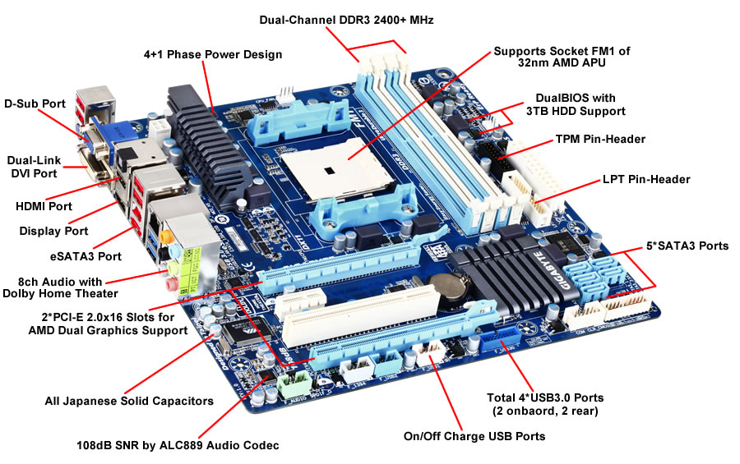
Motherboard
http://www.nitroware.net/reviews/206-mainstream-computing-showdown-amd-a6-v-intel-i3?start=3
Notes:
<number>

Slide 6
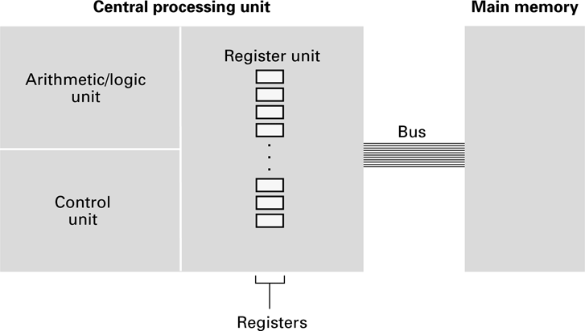
CPU and main memory connected via a bus
<number>

Slide 7
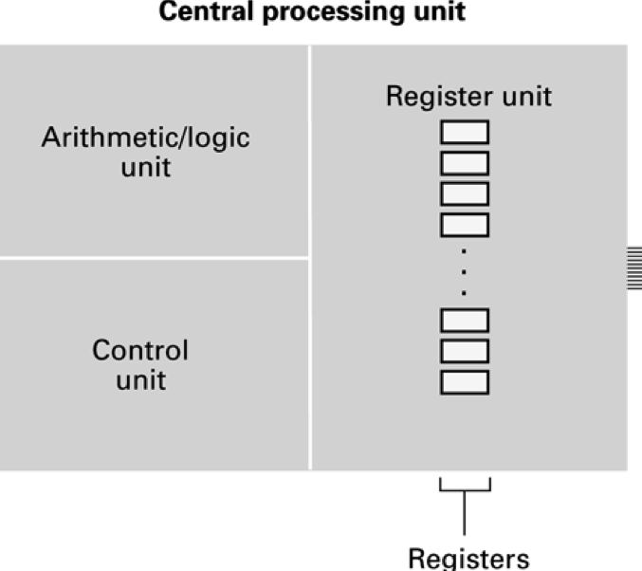
Central Processing Unit (CPU)
Arithmetic/Logic unit (ALU)
Circuitry that performs operations on data
Control unit (CU)
Circuitry that coordinates activities of machine
Registers
General purpose
Temporary holding place for data being manipulated by CPU (inputs to ALU, results produced by ALU)
Special purpose
Particular use – more later
<number>

Slide 8
Key Things to Remember
CPU = ALU + Control Unit
Control Unit handles program execution.
ALU handles for simple math operations.
<number>

Slide 9
Stored Program Concept
Crucial to the flexibility of modern computer systems
Program instructions can be encoded as bit patterns and stored in memory
CPU extracts instructions and executes them
The program can be easily altered
<number>

Slide 10
Terminology
Machine instruction: An instruction (or command) encoded as a bit pattern recognizable by the CPU.
Machine language: The set of all instructions recognized by a machine. Each CPU has its own machine code instruction set.
<number>

Slide 11
Machine Language Philosophies
Reduced Instruction Set Computing (RISC)
Few, simple, efficient, and fast instructions
Examples: PowerPC from Apple/IBM/Motorola
and ARM
Complex Instruction Set Computing (CISC)
Many, convenient, and powerful instructions
Example: Intel
<number>

Slide 12
Machine Instruction Types
Data Transfer: copy data from one location to another
Arithmetic/Logic: use existing bit patterns to compute new bit patterns
Control: direct the execution of the program
<number>

Slide 13
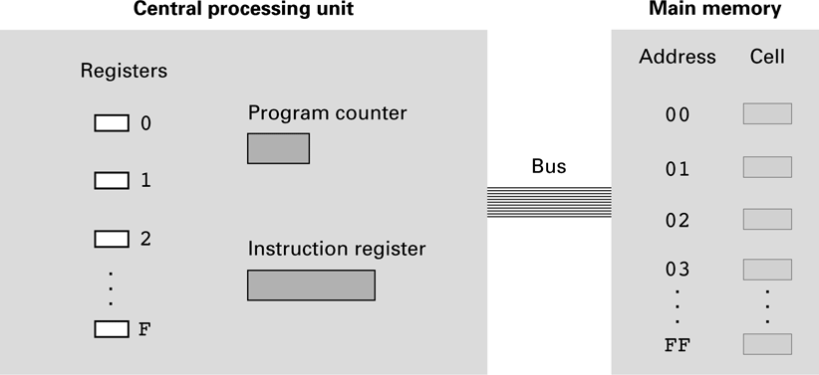
Simple Machine components
We will use a simple but representative machine to explain how computers work.
<number>

Slide 14
Simple Machine components
Machine Architecture
16 general-purpose registers numbered 0 through F (in hexadecimal)
Each register is one byte (eight bits) long
256 cells in the machine’s main memory
Each cell is assigned a unique address represented by a
hexadecimal value in the range of 00 to FF (0 to 255 in
decimal)
Machine’s Language
12 instructions
Each machine instruction is two bytes long
The first 4 bits provide the op-code
The last 12 bits make up the operand field
<number>

Slide 15
Parts of a Machine Instruction
Op-code: Specifies which operation to execute
Operand: Gives more detailed information about the operation
Interpretation of operand varies depending on op-code
<number>

Slide 16
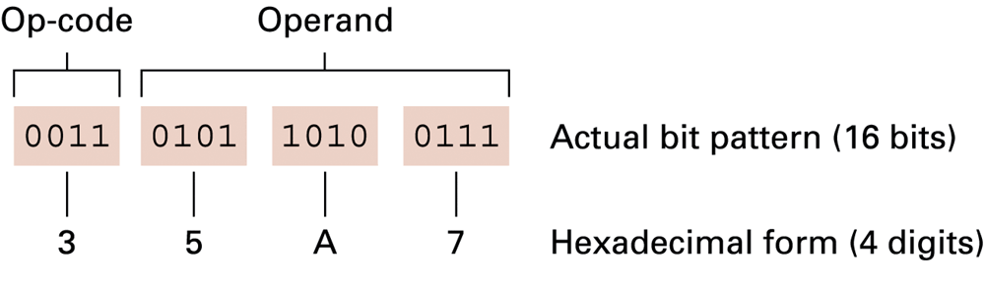
The composition of an instruction for our example machine
<number>

Slide 17
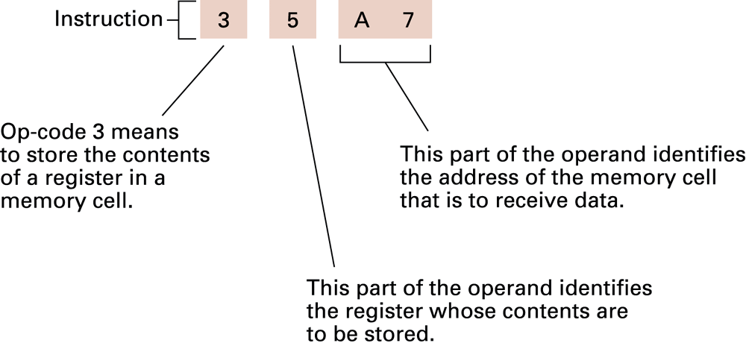
Decoding the instruction 35A7
<number>

Slide 18
Program Execution
Controlled by two special-purpose registers
Program counter: holds address of the next instruction to be executed
Instruction register: holds the current instruction being executed
Machine Cycle
Fetch
Decode
Execute
<number>

Slide 19
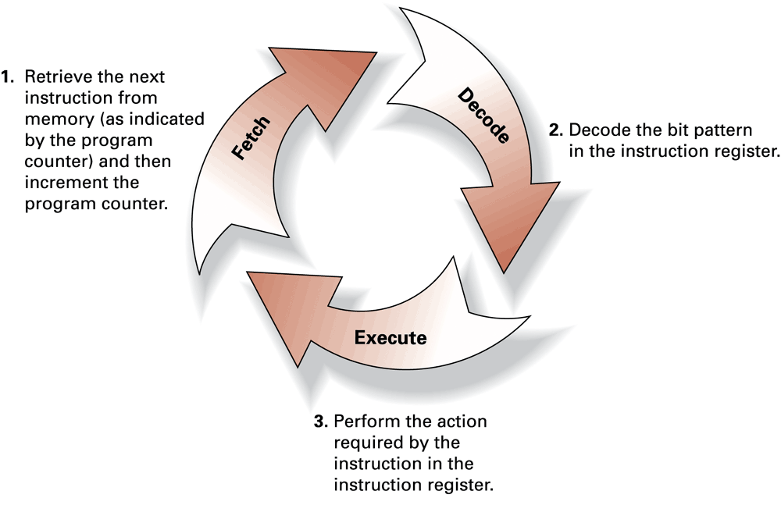
The machine cycle
<number>

Slide 20
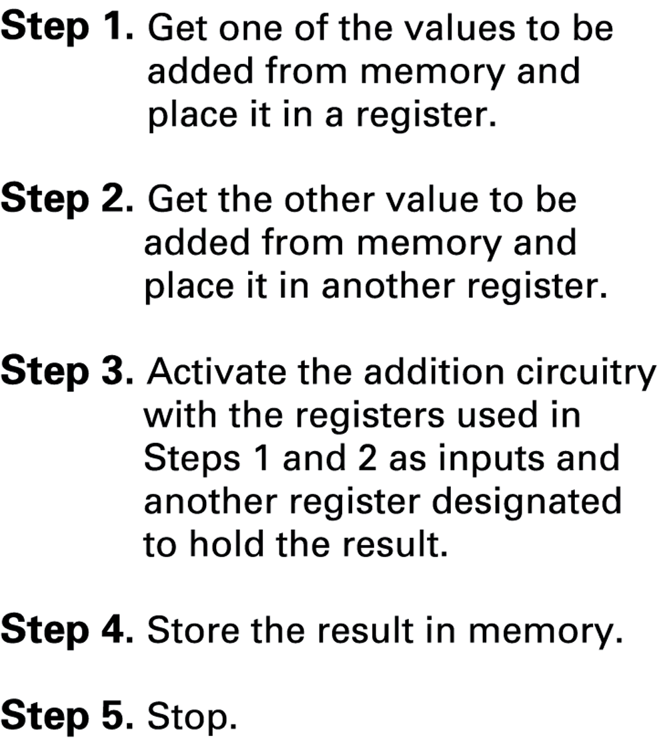
Example: Adding values stored in memory
<number>

Slide 21
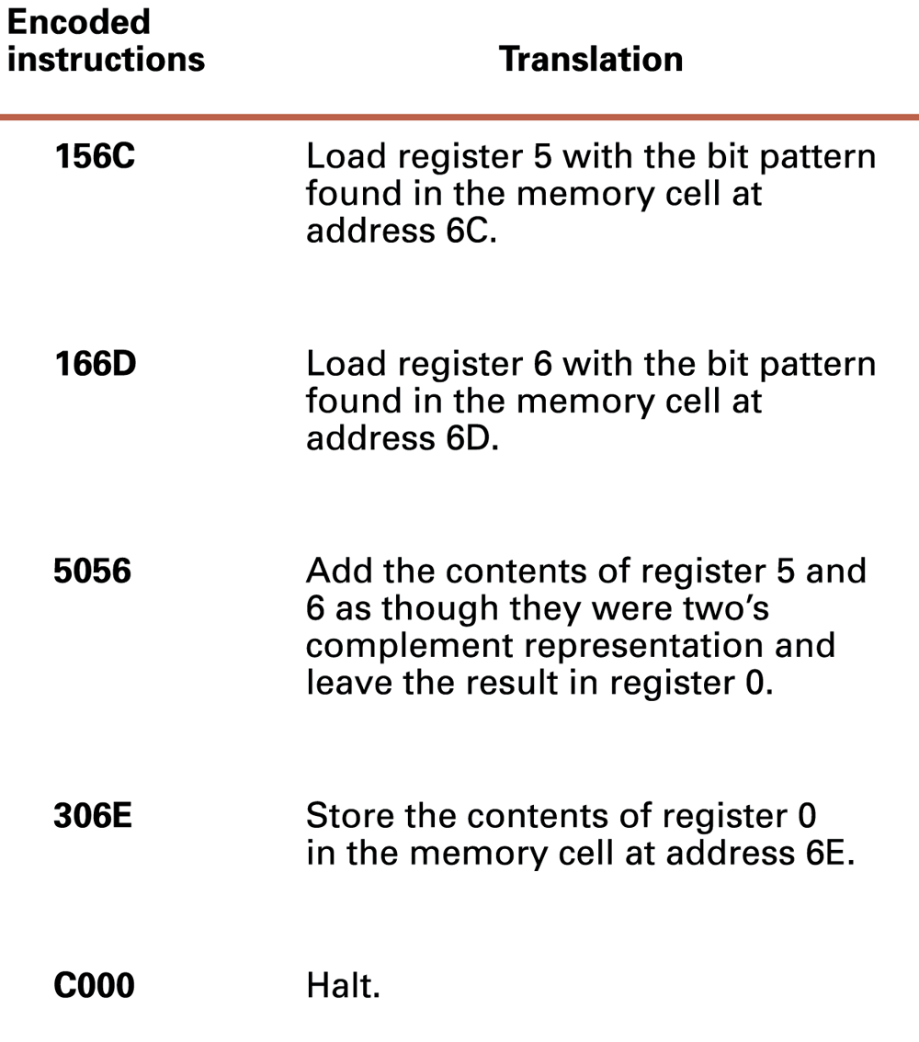
An encoded version of some of the machine instructions
<number>

Slide 22
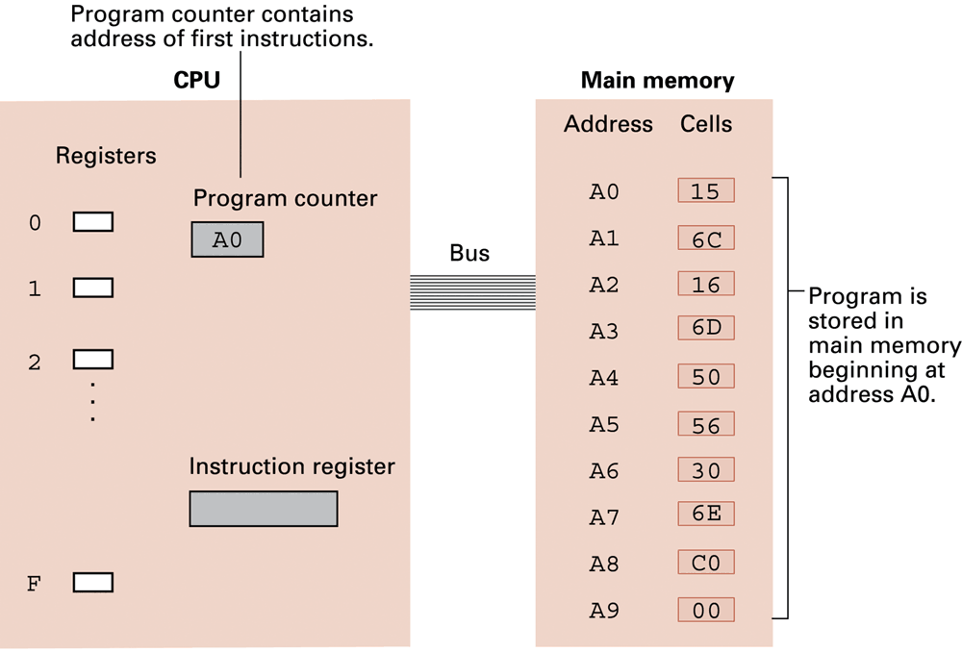
The example program from stored in main memory ready for execution
<number>

Slide 23
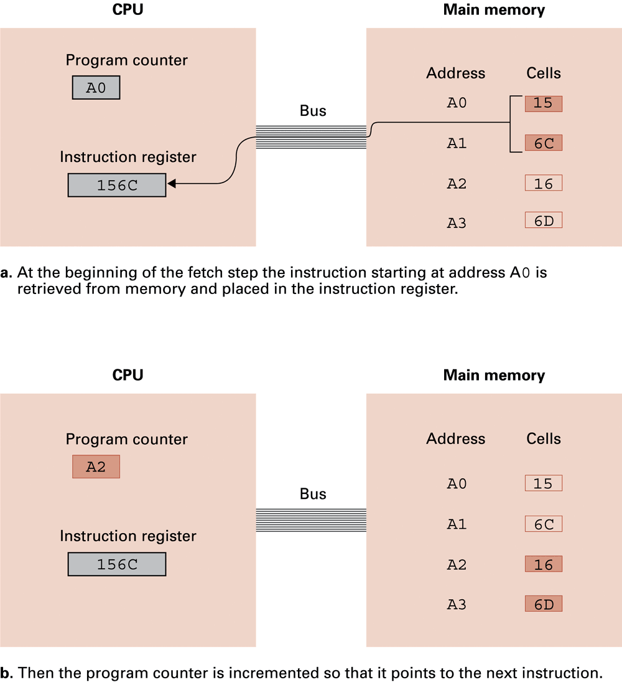
Performing the fetch step of the machine cycle
<number>

Slide 24
Performing the fetch step of the machine cycle (cont’d)
See ProgExeExample.pptx for the complete demonstration of the execution of the program.
<number>

Slide 25
Arithmetic/Logic Operations
Logic: AND, OR, XOR
Masking
Rotate and Shift: circular shift, logical shift, arithmetic shift
Arithmetic: add, subtract, multiply, divide
Precise action depends on how the values are encoded (two’s complement versus floating-point).
<number>

Slide 26
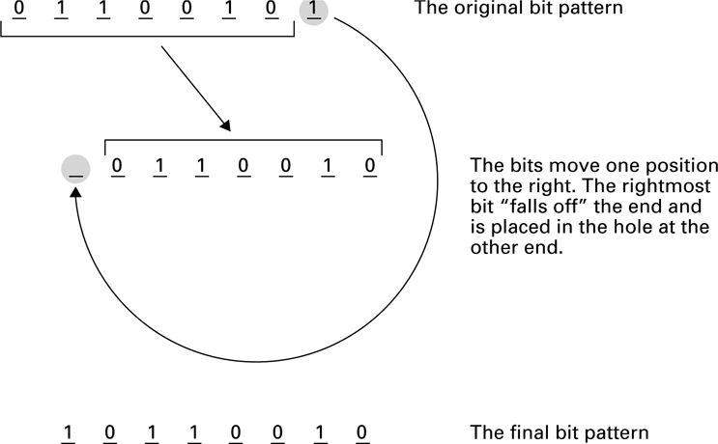
Rotating the bit pattern 65 (hexadecimal) one bit to the right
<number>

Slide 27
Communicating with Other Devices
Controller: An intermediary apparatus that handles communication between the computer and a device
Specialized controllers for each type of device
General purpose controllers (USB and FireWire)
Port: The point at which a device connects to a computer
Memory-mapped I/O: CPU communicates with peripheral devices as though they were memory cells
<number>

Slide 28
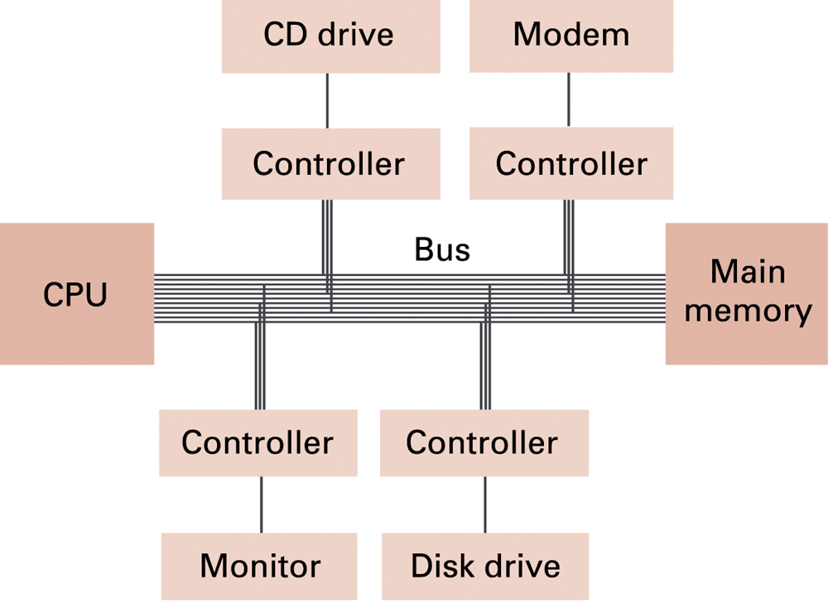
Controllers attached to a machine’s bus
<number>

Slide 29
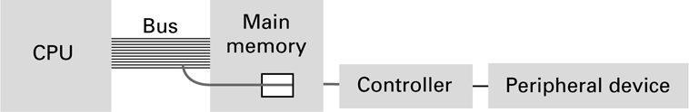
A conceptual representation of memory-mapped I/O
<number>

Slide 30
Communicating with Other Devices (continued)
Direct memory access (DMA):
Main memory access by a controller over the bus
Von Neumann Bottleneck:
Insufficient bus speed impedes performance
Handshaking:
The process of coordinating the transfer of data between components
<number>

Slide 31
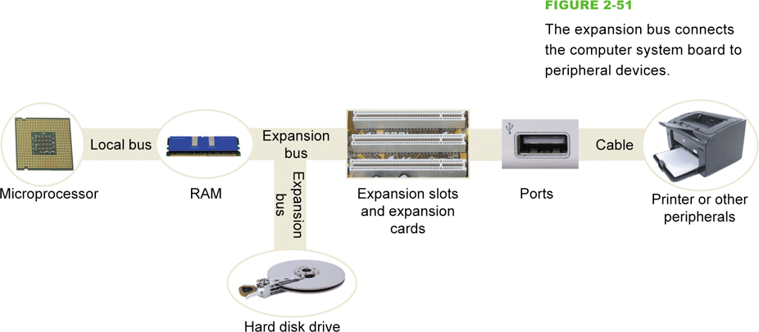
Communicating with Other Devices (continued)
Parallel Communication: Several communication paths transfer bits simultaneously.
Serial Communication: Bits are transferred one after the other over a single communication path.
<number>

Slide 32
Data Communication Rates
Measurement units
bps: Bits per second
Kbps: Kilo-bps (1,000 bps)
Mbps: Mega-bps (1,000,000 bps)
Gbps: Giga-bps (1,000,000,000 bps)
Bandwidth: Maximum available rate
<number>

Slide 33
System Clock
The components of the computer must interact in a synchronized way.
A system clock is used to control the timing of all computer operations.
It generates regular “ticks” (electronic pulses) that set the operating pace of the components.
Its speed is expressed in Megahertz (MHz) or Gigahertz (GHz).

Slide 34
Other Architectures
Technologies to increase throughput:
Pipelining: Overlap steps of the machine cycle
Parallel Processing: Use multiple processors simultaneously
SISD (Single Instruction Single Data): No parallel processing
MIMD (Multiple Instruction Multiple Data): Different programs, different data
SIMD (Single Instruction Multiple Data): Same program, different data
<number>

Slide 35
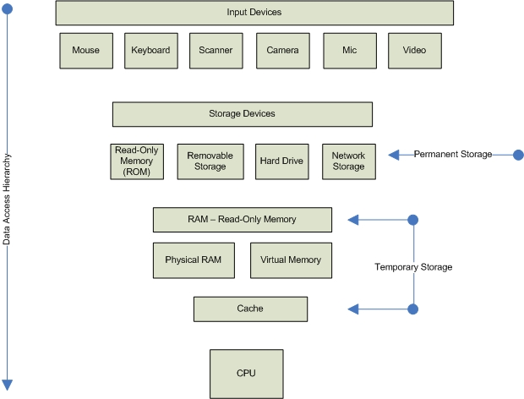
Quick recap

